Slide 1
KNN Algorithm
1 Definition
2 Solved equation
3 Geometrical Representation
4 Where to use?
5 Code Implementation

Slide 2
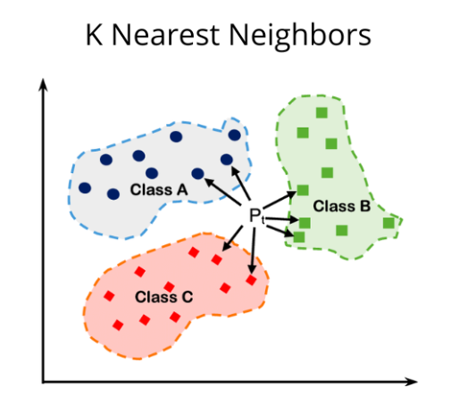
What is KNN? (K-Nearest Neighbors)
KNN (K-Nearest Neighbors) is one of the simplest and most popular supervised machine learning algorithms used for both classification and regression.
It works on a very intuitive idea:
💡 “To classify a new point, look at the K closest points (neighbors) from the training data, and assign the class that is most common among them.”

Slide 3
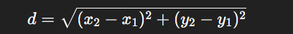
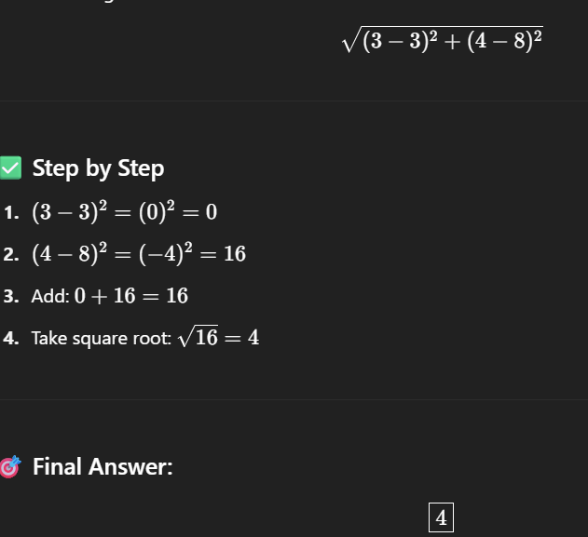
KNN: solved example
Patient = BP = 3, XP = 4 = ?
BP | XP | Disease
3 | 8 | Yes
7 | 2 | No
8 | 2 | No
10 | 8 | Yes
1 | 2 | Yes
Row 1:

Slide 4
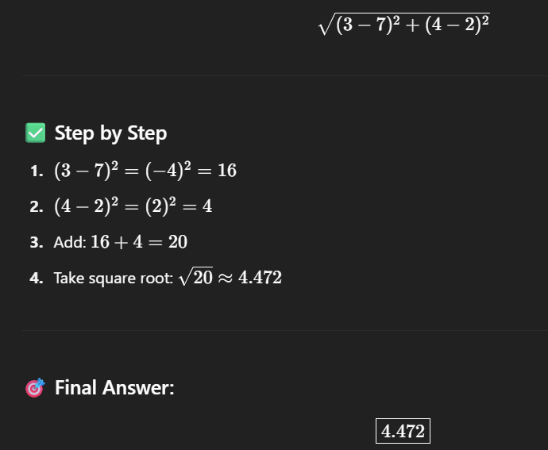
KNN: solved example
Patient = BP = 3, XP = 4 = ?
BP | XP | Disease
3 | 8 | Yes
7 | 2 | No
8 | 2 | No
10 | 8 | Yes
1 | 2 | Yes
Row 2:

Slide 5
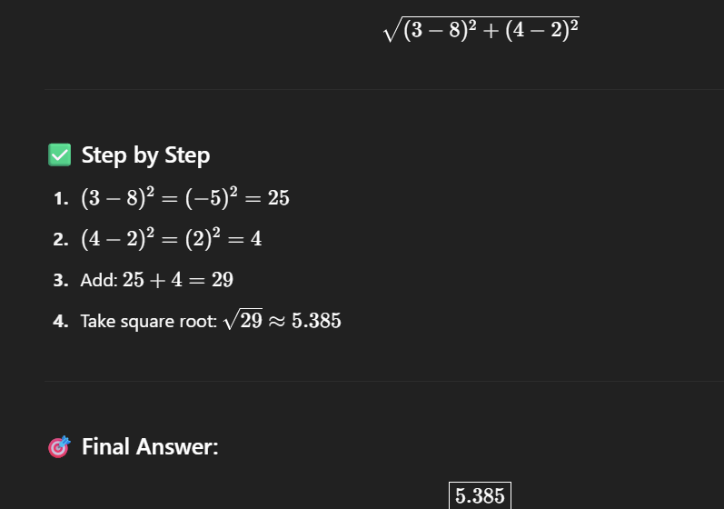
KNN: solved example
Patient = BP = 3, XP = 4 = ?
BP | XP | Disease
3 | 8 | Yes
7 | 2 | No
8 | 2 | No
10 | 8 | Yes
1 | 2 | Yes
Row 3:

Slide 6
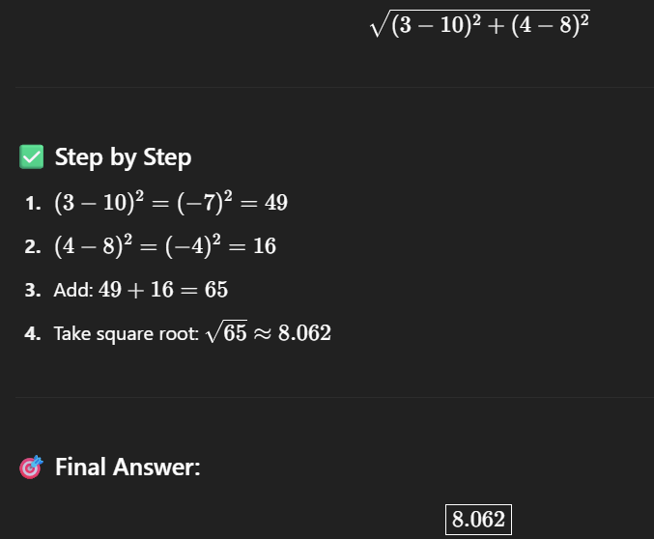
KNN: solved example
Patient = BP = 3, XP = 4 = ?
BP | XP | Disease
3 | 8 | Yes
7 | 2 | No
8 | 2 | No
10 | 8 | Yes
1 | 2 | Yes
Row 4:

Slide 7
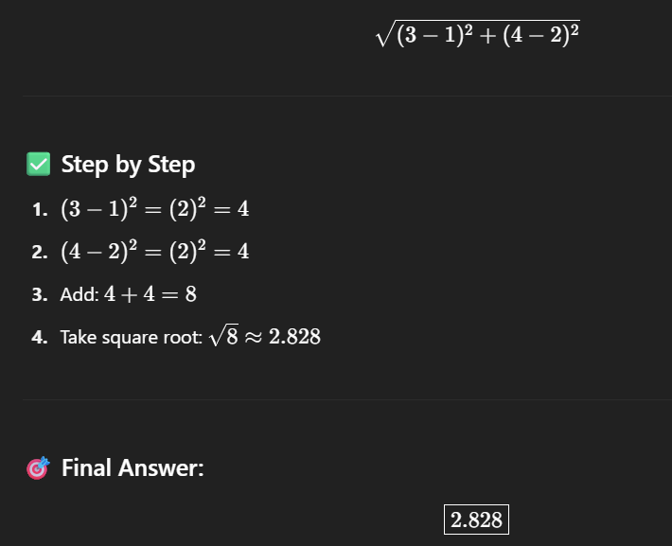
KNN: solved example
Patient = BP = 3, XP = 4 = ?
BP | XP | Disease
3 | 8 | Yes
7 | 2 | No
8 | 2 | No
10 | 8 | Yes
1 | 2 | Yes
Row 5:

Slide 8
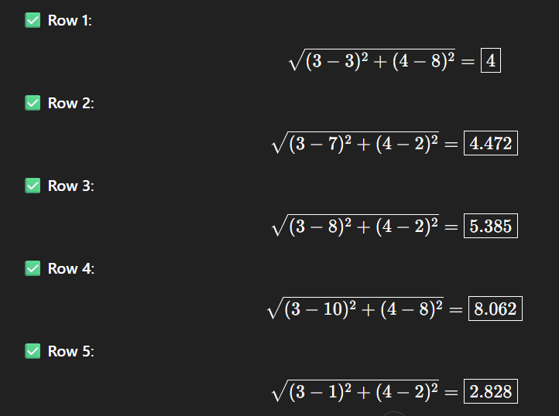
KNN: solved example
Patient = BP = 3, XP = 4 = ?
BP | XP | Disease
3 | 8 | Yes
7 | 2 | No
8 | 2 | No
10 | 8 | Yes
1 | 2 | Yes
K = 3

Slide 9
Geometrical Representation

Slide 10
Applications
Recommender systems (like Netflix, Amazon)
Handwriting recognition (like digit classification)
Medical diagnosis (classifying diseases)

Slide 11
Code Implementation
from sklearn.neighbors import KNeighborsClassifier
# Create KNN classifier (K=3)
knn = KNeighborsClassifier(n_neighbors=3)
# Train the model
knn.fit(X_train, y_train)
# Predict on test set
y_pred = knn.predict(X_test)

